Slide 1
storytelling
you
with

Slide 2

About this deck
This slide deck is a companion resource for the book Storytelling with You: Plan, Create, and Deliver a Stellar Presentation.
You are welcome to use this to learn or teach, with proper attribution: Knaflic, Cole. Storytelling with You: Plan, Create, and Deliver a Stellar Presentation, Wiley, © 2023.
For additional related resources, visit storytellingwithyou.com.
Font: Gill Sans MT
Colors:
FAC700
00A4D8
001855
FD8100
757089
0270DE
C9C6CE
79C1B4

Slide 3
The magic is in the macadamia nuts
Strategic Client Services
Notes:
FIG A.1

Slide 4
Goal today
1
2
Share the findings
from our deep dive analyses and taste test study
Frame a discussion about the relative importance of price vs. consumer preference to determine where to go from here
Notes:
FIG A.2

Slide 5

TRIX trail: the path we took
PROJECT
INCEPTION
Competitor analysis
Taste test study design
The price of nuts
(and other ingredients)
Packaging
Taste test analysis
TODAY
Notes:
FIG A.3

Slide 6
The TRIX story
PROJECTED
Notes:
FIG A.4

Slide 7
The TRIX story
TRIX trail mix
TRIX bites
PROJECTED
Notes:
FIG A.5

Slide 8
The TRIX story
TRIX trail mix
Competitor A
Competitor B
TRIX bars
Competitor C
TRIX bites
PROJECTED
Notes:
FIG A.6

Slide 9
The TRIX story
TRIX trail mix
Competitor A
Competitor B
TRIX bars
Competitor C
TRIX bites
PROJECTED
Notes:
FIG A.7

Slide 10
The TRIX story
TRIX trail mix
Competitor A
Competitor B
TRIX bars
Competitor C
TRIX bites
PROJECTED
Notes:
FIG A.8

Slide 11
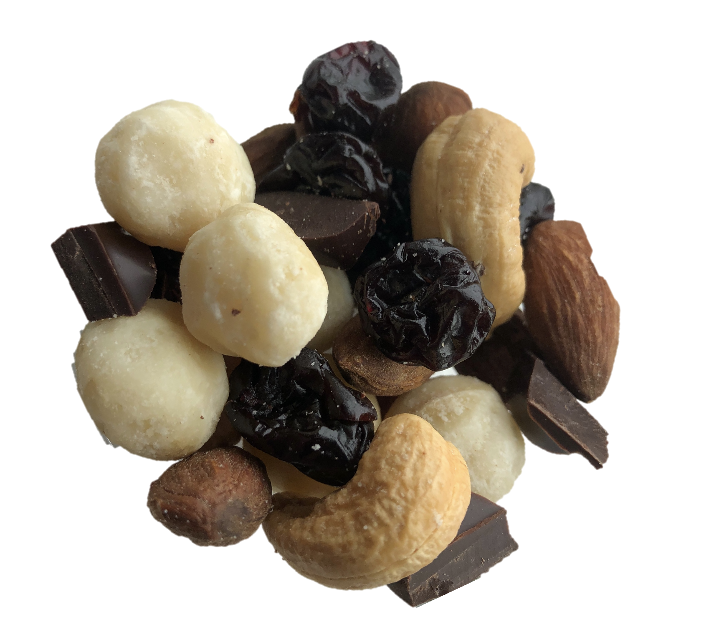
5 simple ingredients
Notes:
FIG A.9

Slide 12
Whole macadamia nuts are key
Notes:
FIG A.10

Slide 13
37%
Ah, nuts!
macadamia nut price increase
Notes:
FIG A.11

Slide 14
Initial decision:
increase decrease
PRICE COST
Notes:
FIG A.12

Slide 15
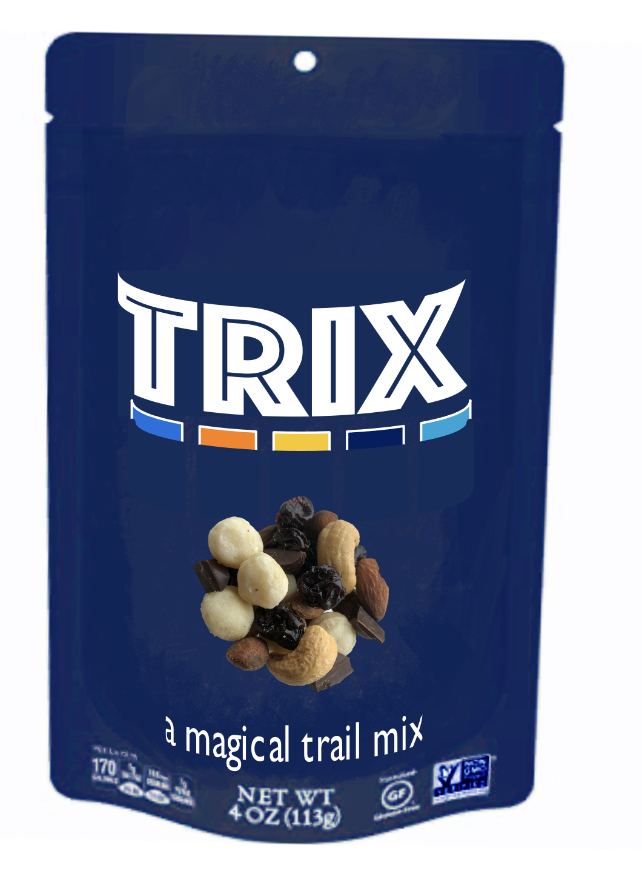
We tested packaging
Notes:
FIG A.13

Slide 16
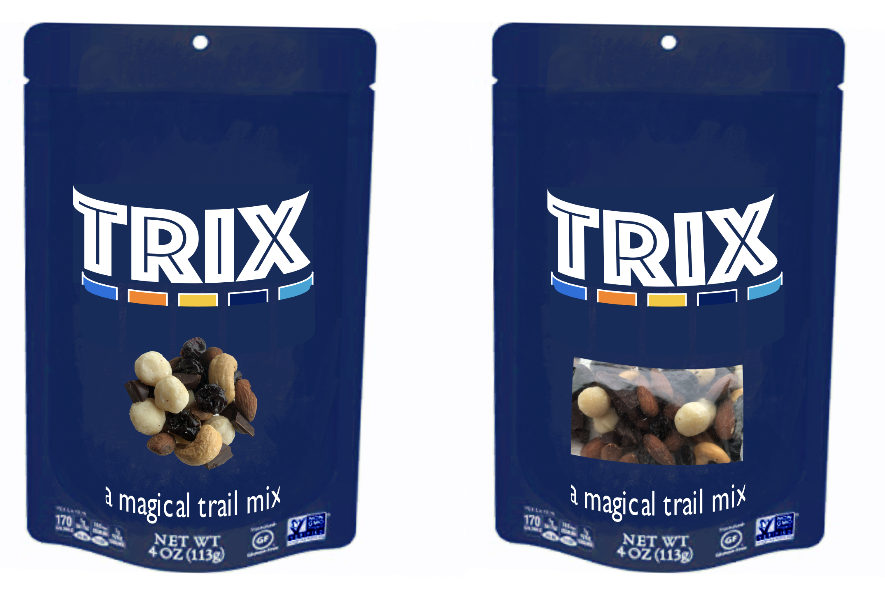
Update package: window increases purchase intent
Notes:
FIG A.14

Slide 17
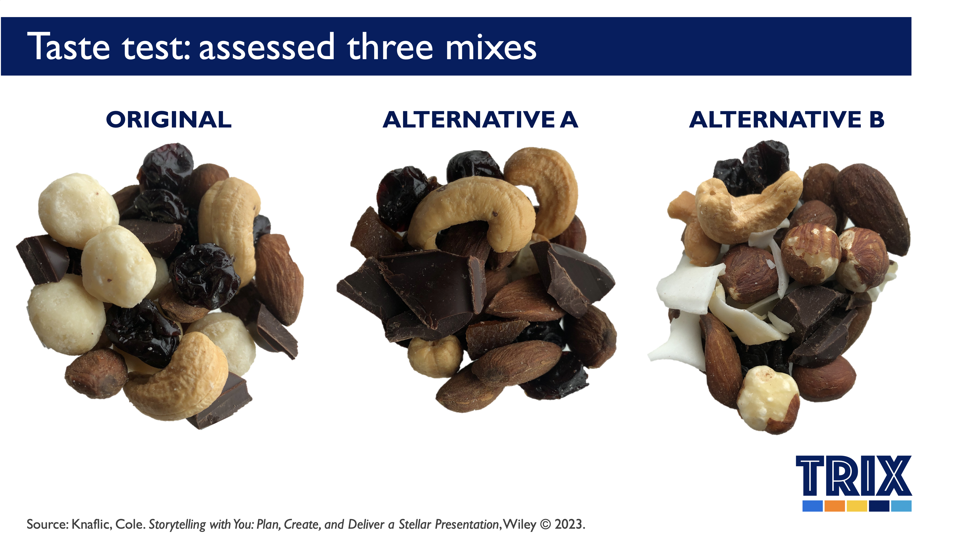
Taste test: assessed three mixes
ORIGINAL
ALTERNATIVE A
ALTERNATIVE B
Notes:
FIG A.15

Slide 18
8.1
ORIGINAL
is preferred…
overall liking on a scale of 1 to 9*
N=257 *The action standard was set at 95% level of confidence.
How much do you like or dislike the sample overall?
Notes:
FIG A.16

Slide 19
We started with a simple question
DISLIKE EXTREMELY LIKE EXTREMELY
ORIGINAL
ALTERNATIVE A
ALTERNATIVE B
Notes:
FIG A.17

Slide 20
Participants prefer the original mix
DISLIKE EXTREMELY LIKE EXTREMELY
ORIGINAL
ALTERNATIVE A
ALTERNATIVE B
Notes:
FIG A.18

Slide 21
Participants prefer the original mix
DISLIKE EXTREMELY LIKE EXTREMELY
ORIGINAL
ALTERNATIVE A
ALTERNATIVE B
Notes:
FIG A.19

Slide 22
Participants prefer the original mix
DISLIKE EXTREMELY LIKE EXTREMELY
OVERALL
ORIGINAL
ALTERNATIVE A
ALTERNATIVE B
Notes:
FIG A.20

Slide 23
We also assessed appearance, texture, & taste
DISLIKE EXTREMELY LIKE EXTREMELY
OVERALL
APPEARANCE
TEXTURE
TASTE
Notes:
FIG A.21

Slide 24
People like each of these dimensions for original mix
DISLIKE EXTREMELY LIKE EXTREMELY
OVERALL
APPEARANCE
TEXTURE
TASTE
Notes:
FIG A.22

Slide 25
People like both alternative mixes less
DISLIKE EXTREMELY LIKE EXTREMELY
OVERALL
APPEARANCE
TEXTURE
TASTE
Notes:
FIG A.23

Slide 26
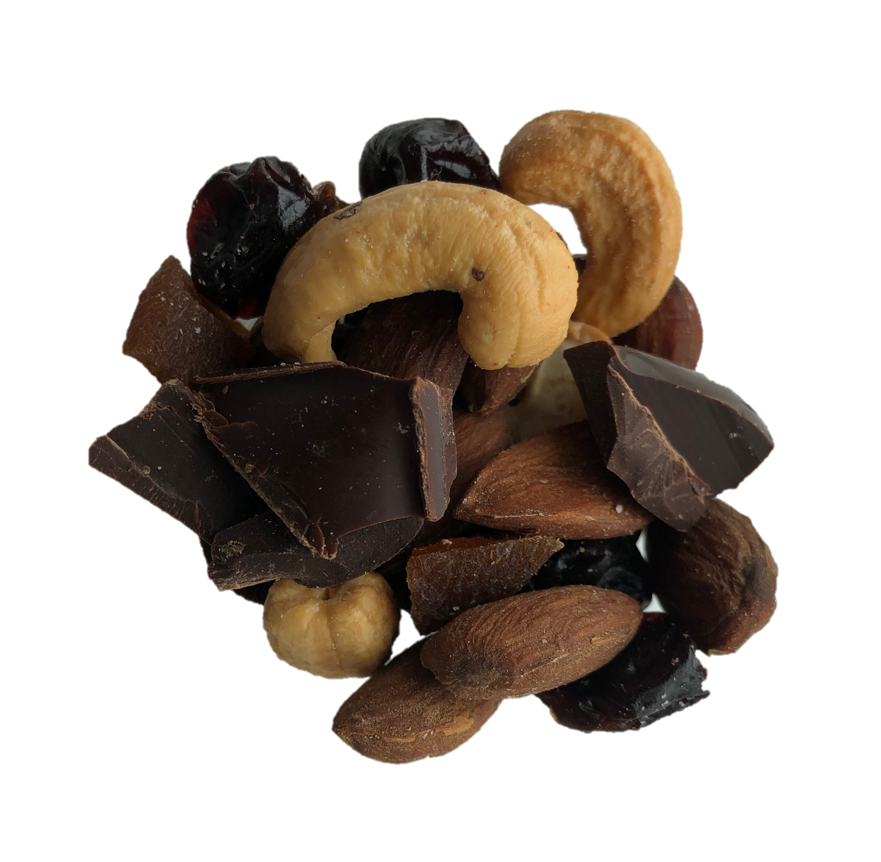
Focus on Alternative A
DISLIKE EXTREMELY LIKE EXTREMELY
OVERALL
APPEARANCE
TEXTURE
TASTE
Notes:
FIG A.24

Slide 27
Alternative A: low on appearance & texture
DISLIKE EXTREMELY LIKE EXTREMELY
OVERALL
APPEARANCE
TEXTURE
TASTE
Notes:
FIG A.25

Slide 28
Participants also assessed relative amounts
TOO LITTLE | JUST ABOUT RIGHT | TOO MUCH
Notes:
FIG A.26

Slide 29
Alternative A: let’s look at the detail
TOO LITTLE | JUST ABOUT RIGHT | TOO MUCH
Notes:
FIG A.27

Slide 30
Alternative A: apricots throw mix out of balance
TOO LITTLE | JUST ABOUT RIGHT | TOO MUCH
Notes:
FIG A.28

Slide 31
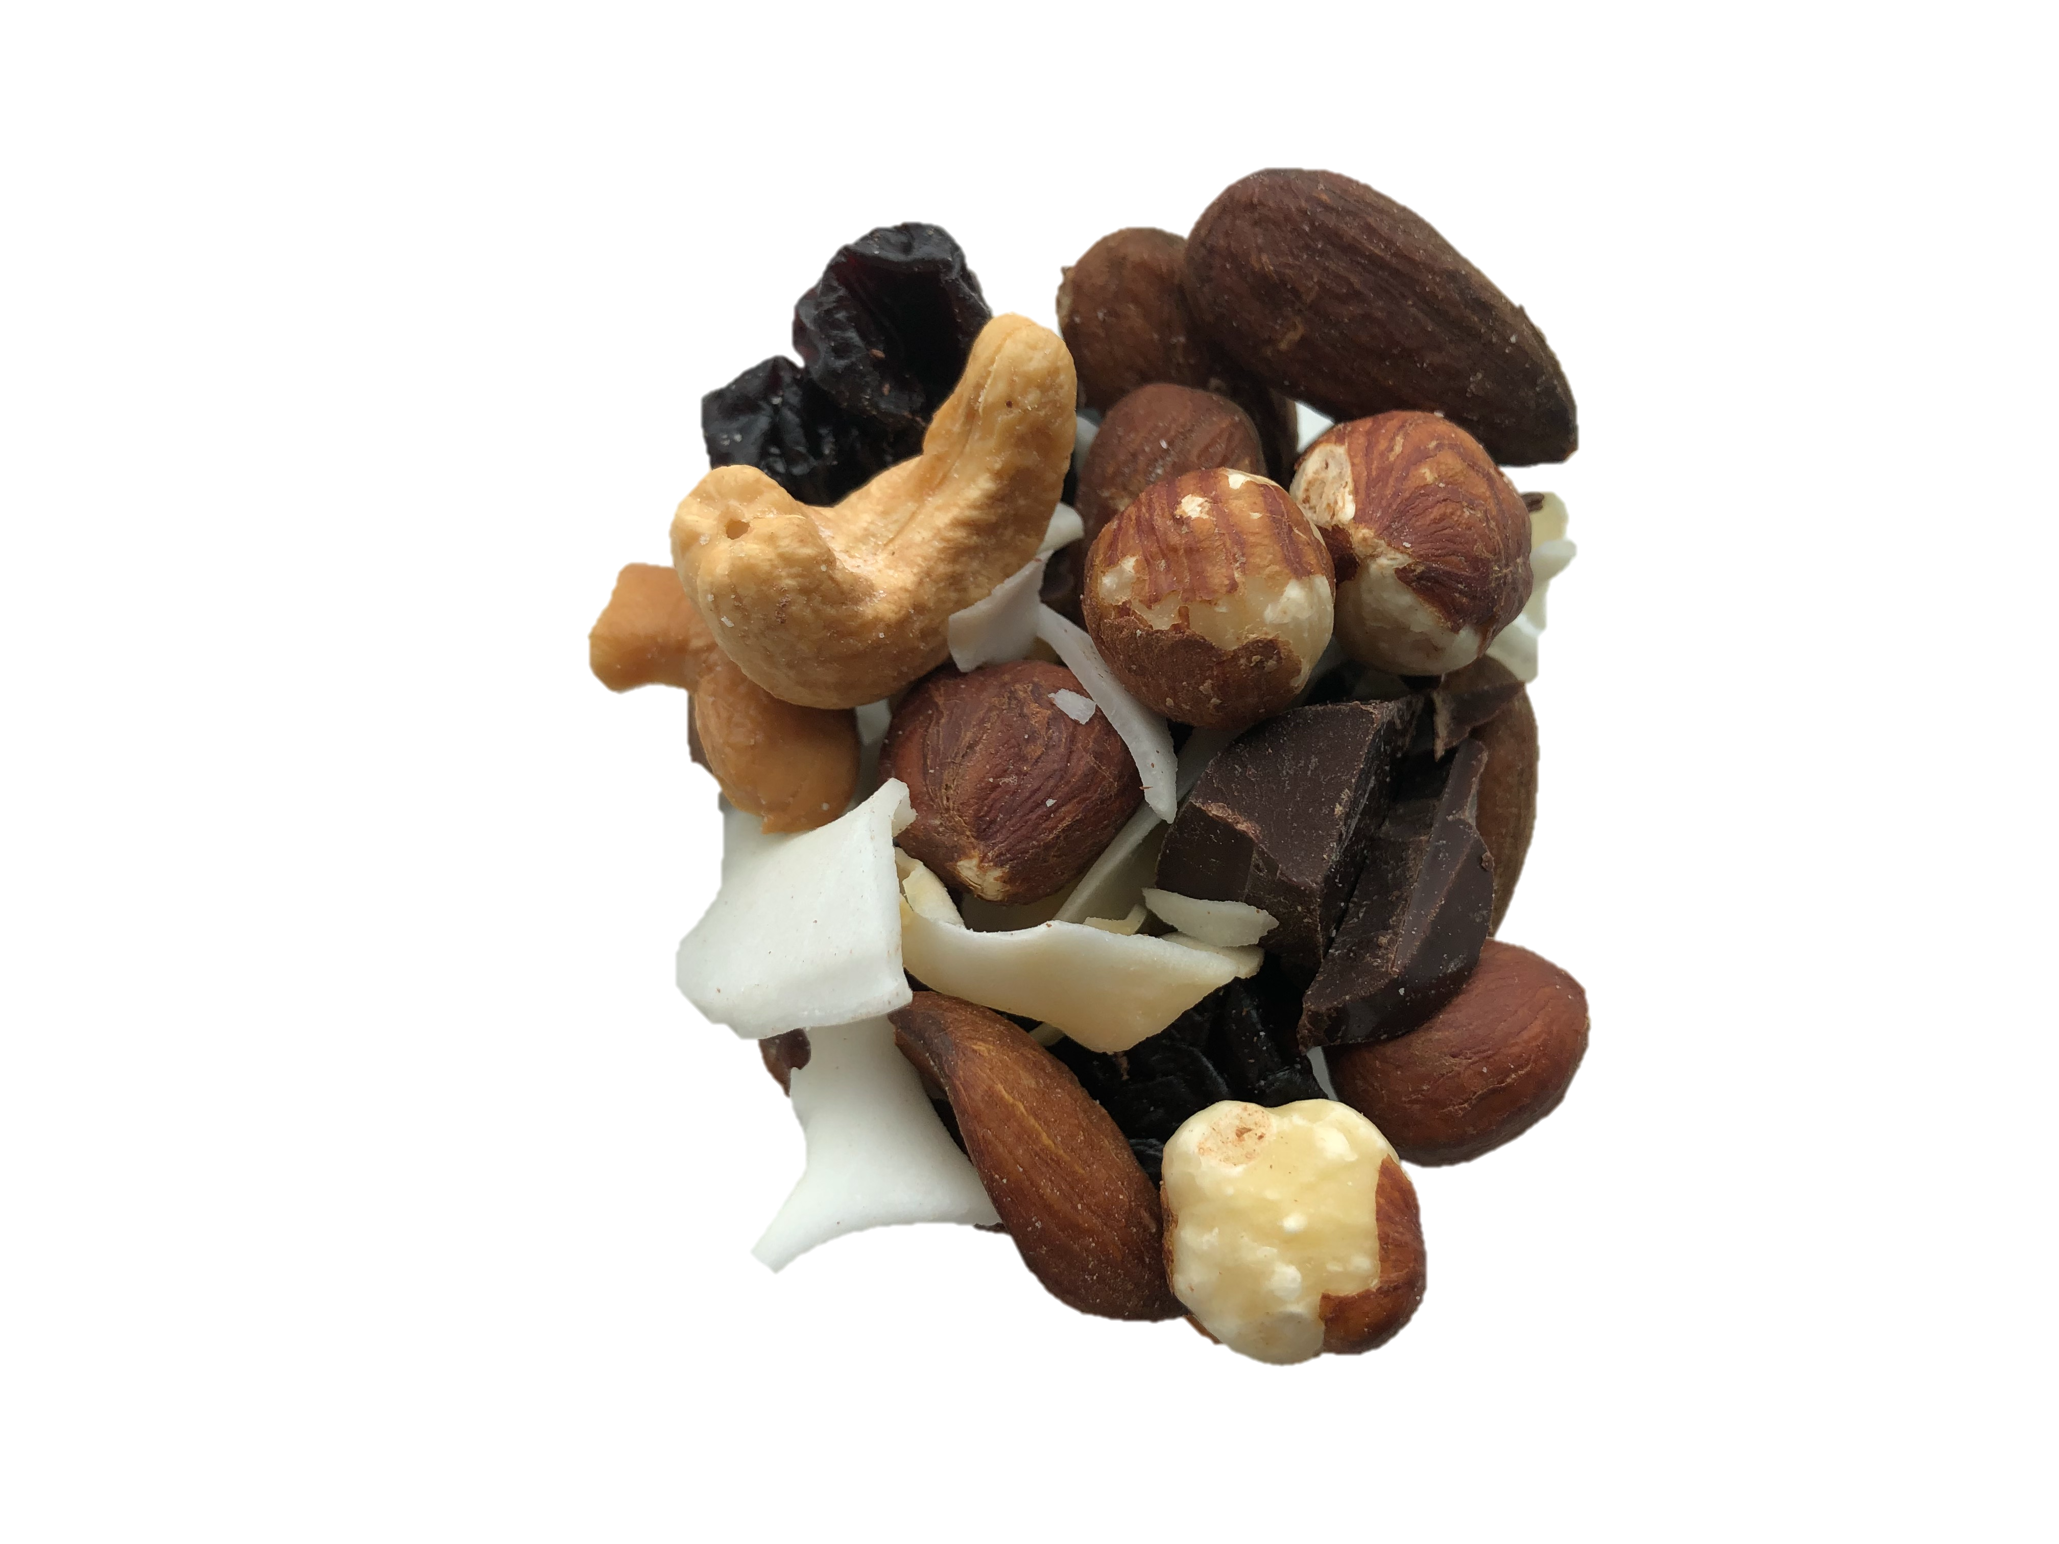
Focus on Alternative B
DISLIKE EXTREMELY LIKE EXTREMELY
OVERALL
APPEARANCE
TEXTURE
TASTE
Notes:
FIG A.29

Slide 32
Alternative B: scores low on taste
DISLIKE EXTREMELY LIKE EXTREMELY
OVERALL
APPEARANCE
TEXTURE
TASTE
Notes:
FIG A.30

Slide 33
Alternative B: let’s look at the detail
TOO LITTLE | JUST ABOUT RIGHT | TOO MUCH
Notes:
FIG A.31

Slide 34
Alternative B: many aspects are in balance
TOO LITTLE | JUST ABOUT RIGHT | TOO MUCH
Notes:
FIG A.32

Slide 35
Alternative B: too salty
TOO LITTLE | JUST ABOUT RIGHT | TOO MUCH
Notes:
FIG A.33

Slide 36
Participants assessed individual ingredients
DISLIKE EXTREMELY LIKE EXTREMELY
Notes:
FIG A.34

Slide 37
Liking varies markedly by ingredient
DISLIKE EXTREMELY LIKE EXTREMELY
Notes:
FIG A.35

Slide 38
People love macadamia nuts (we knew that!)
DISLIKE EXTREMELY LIKE EXTREMELY
Notes:
FIG A.36

Slide 39
Many people dislike hazelnuts
DISLIKE EXTREMELY LIKE EXTREMELY
Notes:
FIG A.37

Slide 40
Unexpected finding: people really like coconut
DISLIKE EXTREMELY LIKE EXTREMELY
Notes:
FIG A.38

Slide 41
“
The apricot one was awful, but
I really liked the coconut.
It added good crunch.
Have you thought about adding coconut to the mix with the macadamia nuts?
I’d buy that!
Notes:
FIG A.39

Slide 42
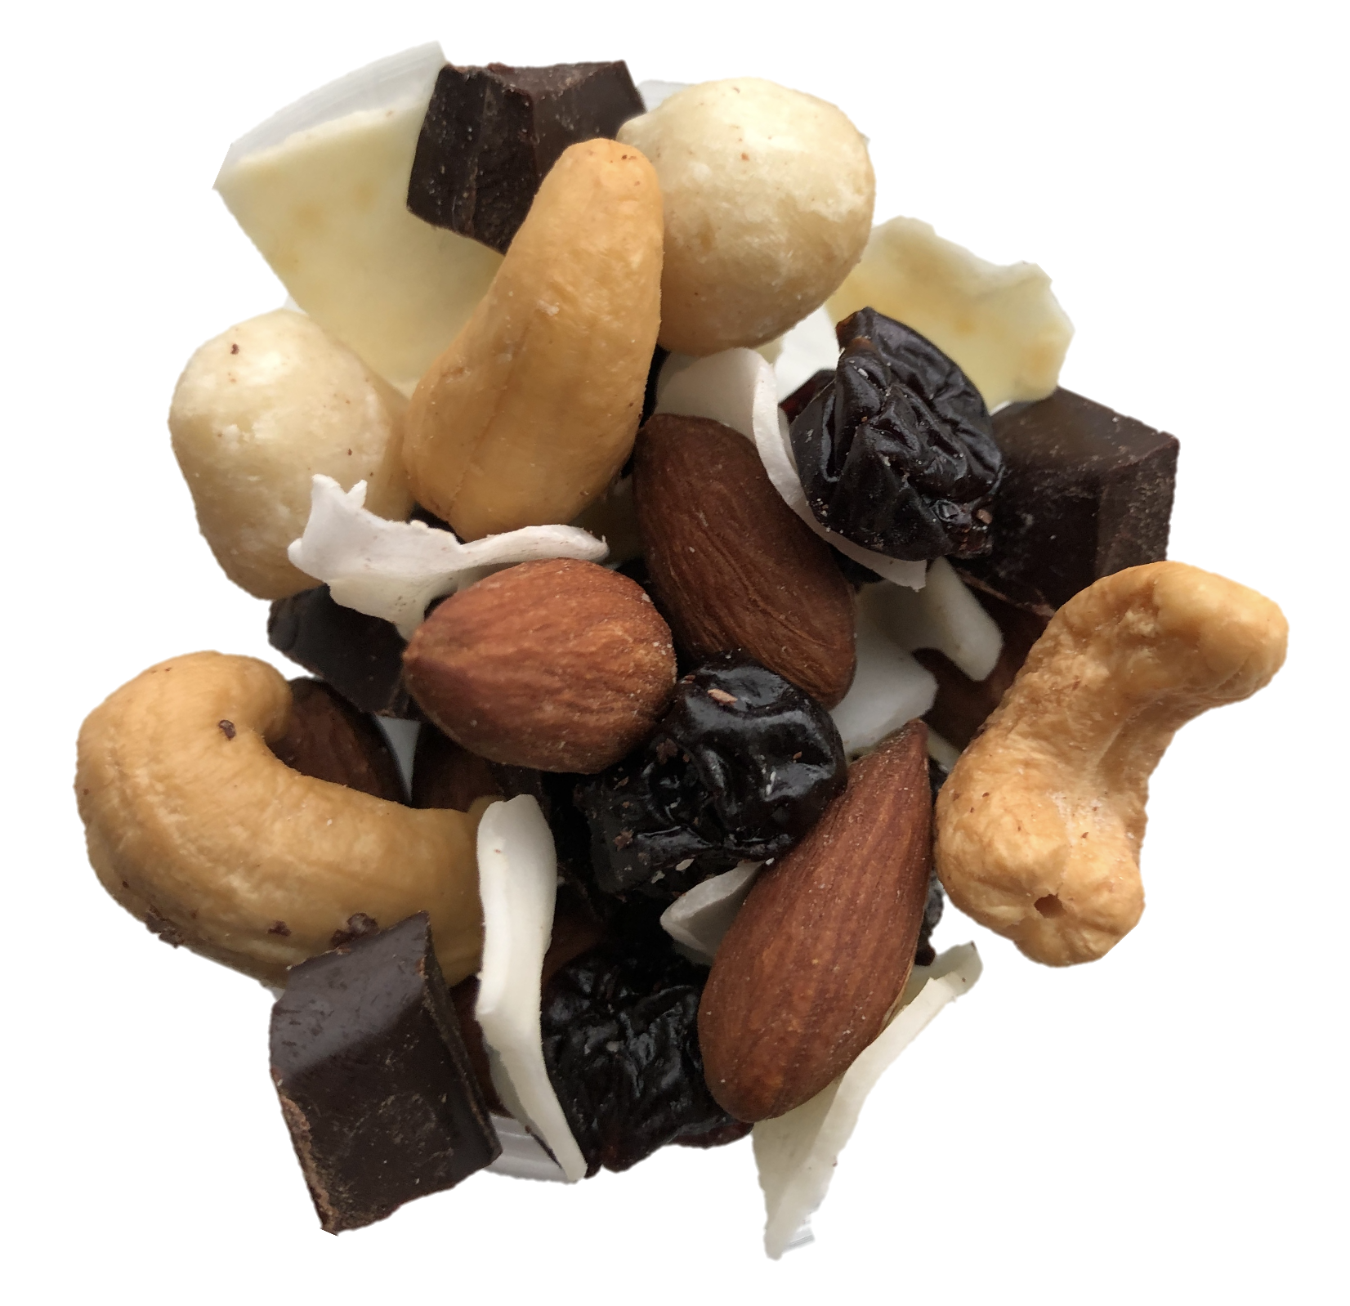
Recommendation: a new alternative mix
Notes:
FIG A.40

Slide 43
Three options to consider
1
2
3
Raise price
Keep the current mix
Go direct to market with new alternative mix Reduce macadamia nuts, introduce coconut
Run additional tests & analysis
Test new alternative mix, then reassess
Notes:
FIG A.41

Slide 44
The magic is in the macadamia nuts
Strategic Client Services
Notes:
FIG A.42

